Slide 1
WebRTC
From Zero to Hero
VinnytsiaJS conference, 21.07.2018
Gabriel Mičko
https://talks.webrtc.rocks

Slide 2

Who am I? 📖
Gabriel Mičko
gabriel_micko
gabriel.micko
📨
gabriel@webrtc.rocks

Slide 3
Volunteer & Tech Speaker

Slide 4
Docler SSC - Streaming engineer

Slide 5


Slide 6
Web real-time communication
Voice calling, Video chat, P2P File sharing, Screen sharing
Without internal or external plugin
Meant to be rich, high-quality
Browser, mobile platforms, and IoT devices
UDP transport layer
Secure (DTLS)
https://webrtc.org

Slide 7
Let's see a demo
https://dialin.webrtc.rocks/

Slide 8
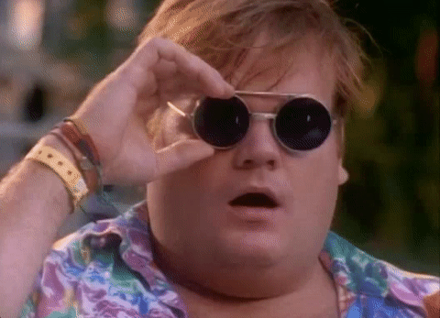

Slide 9
Before I show the code...

Slide 10
WebRTC Connection
🙋
🧙‍♂️
🙋‍♂️
?

Slide 11
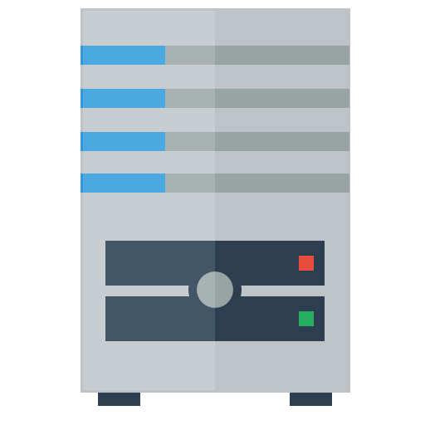
WebRTC Connection
🙋
🙋‍♂️
Signalling server

Slide 12
What the hack is?
Signalling server, responsible for exchanging the necessary information between two peers. Information such as:
RTCPeerConnection offer
RTCPeerConnection answer
ICE candidates
STUN server, service for detecting your public IP
TURN server, relay between 2 clients, it is going to be used in case P2P connection cannot be negotiated for any reason.
https://github.com/coturn/rfc5766-turn-server/

Slide 13
new RTCPeerConnection({
iceServers: []
});
navigator.mediaDevices.enumerateDevices()
navigator.mediaDevices.getUserMedia()
WebRTC API basics
RTCPeerConnection, which sets up audio and video calls, generates ICE candidate, offer, answer, stats.
enumerateDevices gathers all the hardware devices (audio / video) available for you.
getUserMedia, which allows a web browser to access the camera and microphone and to capture media

Slide 14
Session description protocol
Dating back to 90’s
String-based business card generated by RTCPeerConnection
Audio and video codecs
Network lookup
Computer data weight
Easy transportation

Slide 15
new RTCSessionDescription(sdpOffer);
new RTCIceCandidate(candidate);
/**
* Example for crating RTCDataChannel instance
* dataChannel will be instanceof RTCDataChannel
*/
const dataChannel = rtcPCInstance.createDataChannel();
WebRTC API basics
RTCSessionDescription, represents the session description in more readable format.
RTCIceCandidate provides information where the data is going to be exchanged in the network
RTCDataChannel, which allows a browser to share data peer-to-peer

Slide 16
WebRTC Connection
Creates an offer
❤️
Forwards the offer
🙋
🙋‍♂️
Shares ICE candidates
Signalling server
Forwards the answer
Creates an answer

Slide 17
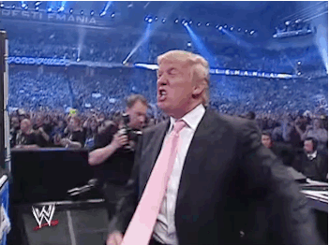
Let's code!

Slide 18
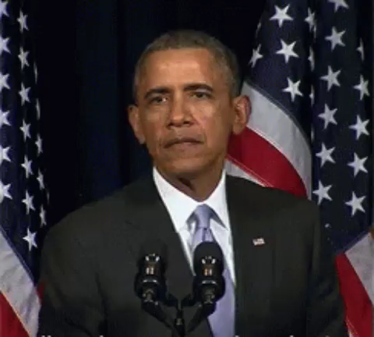

Slide 19
Cool WebRTC features
Canvas as the source of video stream
Screen sharing
Simulcast support
ICE Restart
Full Duplex across all platforms
100% Promise based

Slide 20
Who uses WebRTC?
Statistics
> 1.5 Billion weekly Chrome audio / video minutes, + 45% since last year
Facebook messenger
WhatsApp
Discord
Google Hangout
Slack
Appear.in

Slide 21
Debugging
Browser integrated
Chrome (chrome://webrtc-logs, chrome://webrtc-internals)
Firefox (about:webrtc)
JS library
WebRTC analyzer (https://github.com/DoclerLabs/webrtc-analyzer)
getStats (https://github.com/muaz-khan/getStats)

Slide 22
Alliance for Open Media
Next generation media format (AV1)
Open
Works on the Web
Fits to any modem, device and bandwidth
Capable of streaming high quality real-time video
Secure (DTLS)
Backers like: Mozilla, Google, MS, Amazon, Intel
https://aomedia.org/

Slide 23
Browser support

Slide 24
WebRTC Adapter
adapter.js is a shim to insulate apps from spec changes and prefix differences.
In fact, the standards and protocols used for WebRTC implementations are highly stable, and there are only a few prefixed names.
https://github.com/webrtc/adapter

Slide 25
WebVR 💘 WebRTC
Video and Voice chat in VR
Peer to peer games like table tennis
Using devices as controllers (ProxyControls.JS) https://proxy-controls.donmccurdy.com/demo
WebTorrent https://webtorrent.io/

Slide 26
WebRTC Multipoint control unit
Start streaming
Play the stream
💻
Media Server
📱
Fancy stuff
🤡
Kurento | Janus | Jitsi

Slide 27
Is WebRTC Ready?
https://webrtchacks.com
http://iswebrtcreadyyet.com/
http://realtimeweekly.co/
https://webrtcweekly.com
http://www.webrtc.org/
https://bloggeek.me/

Slide 28

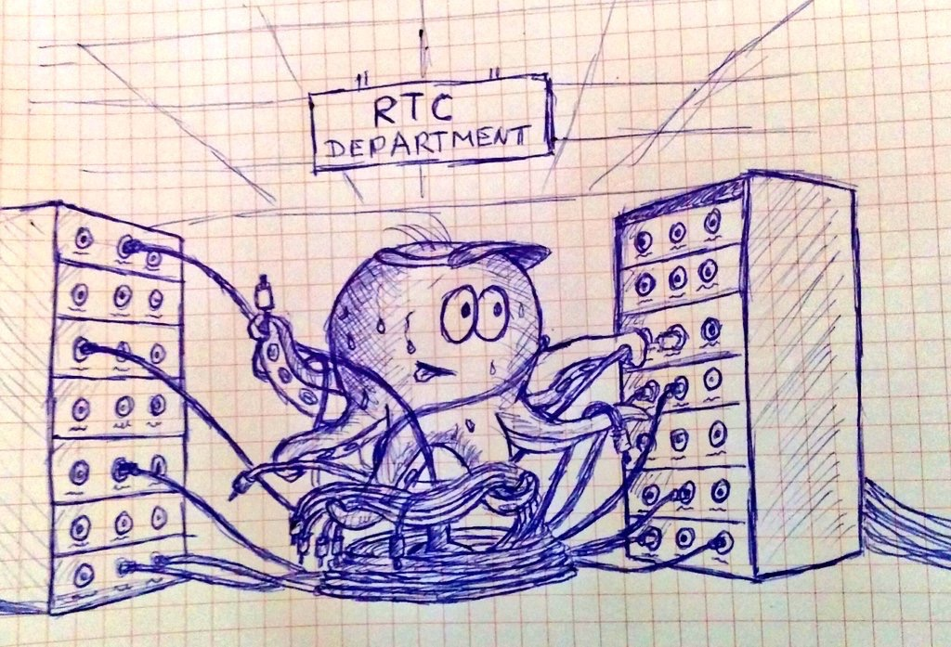
Thank you!

Slide 29
Questions?
Gabriel Mičko
gabriel_micko
gabriel.micko
📨
gabriel@webrtc.rocks

